Slide 1

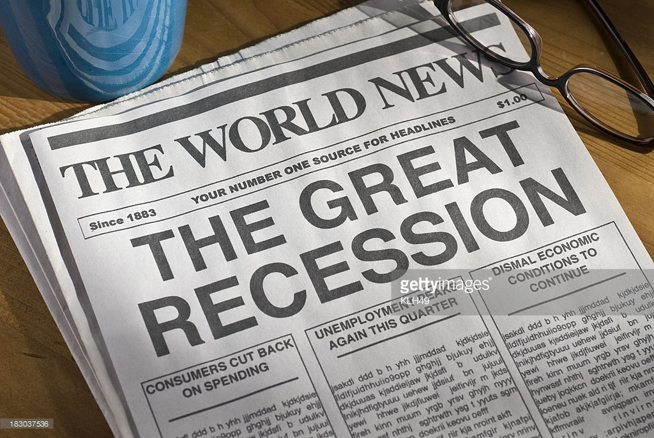
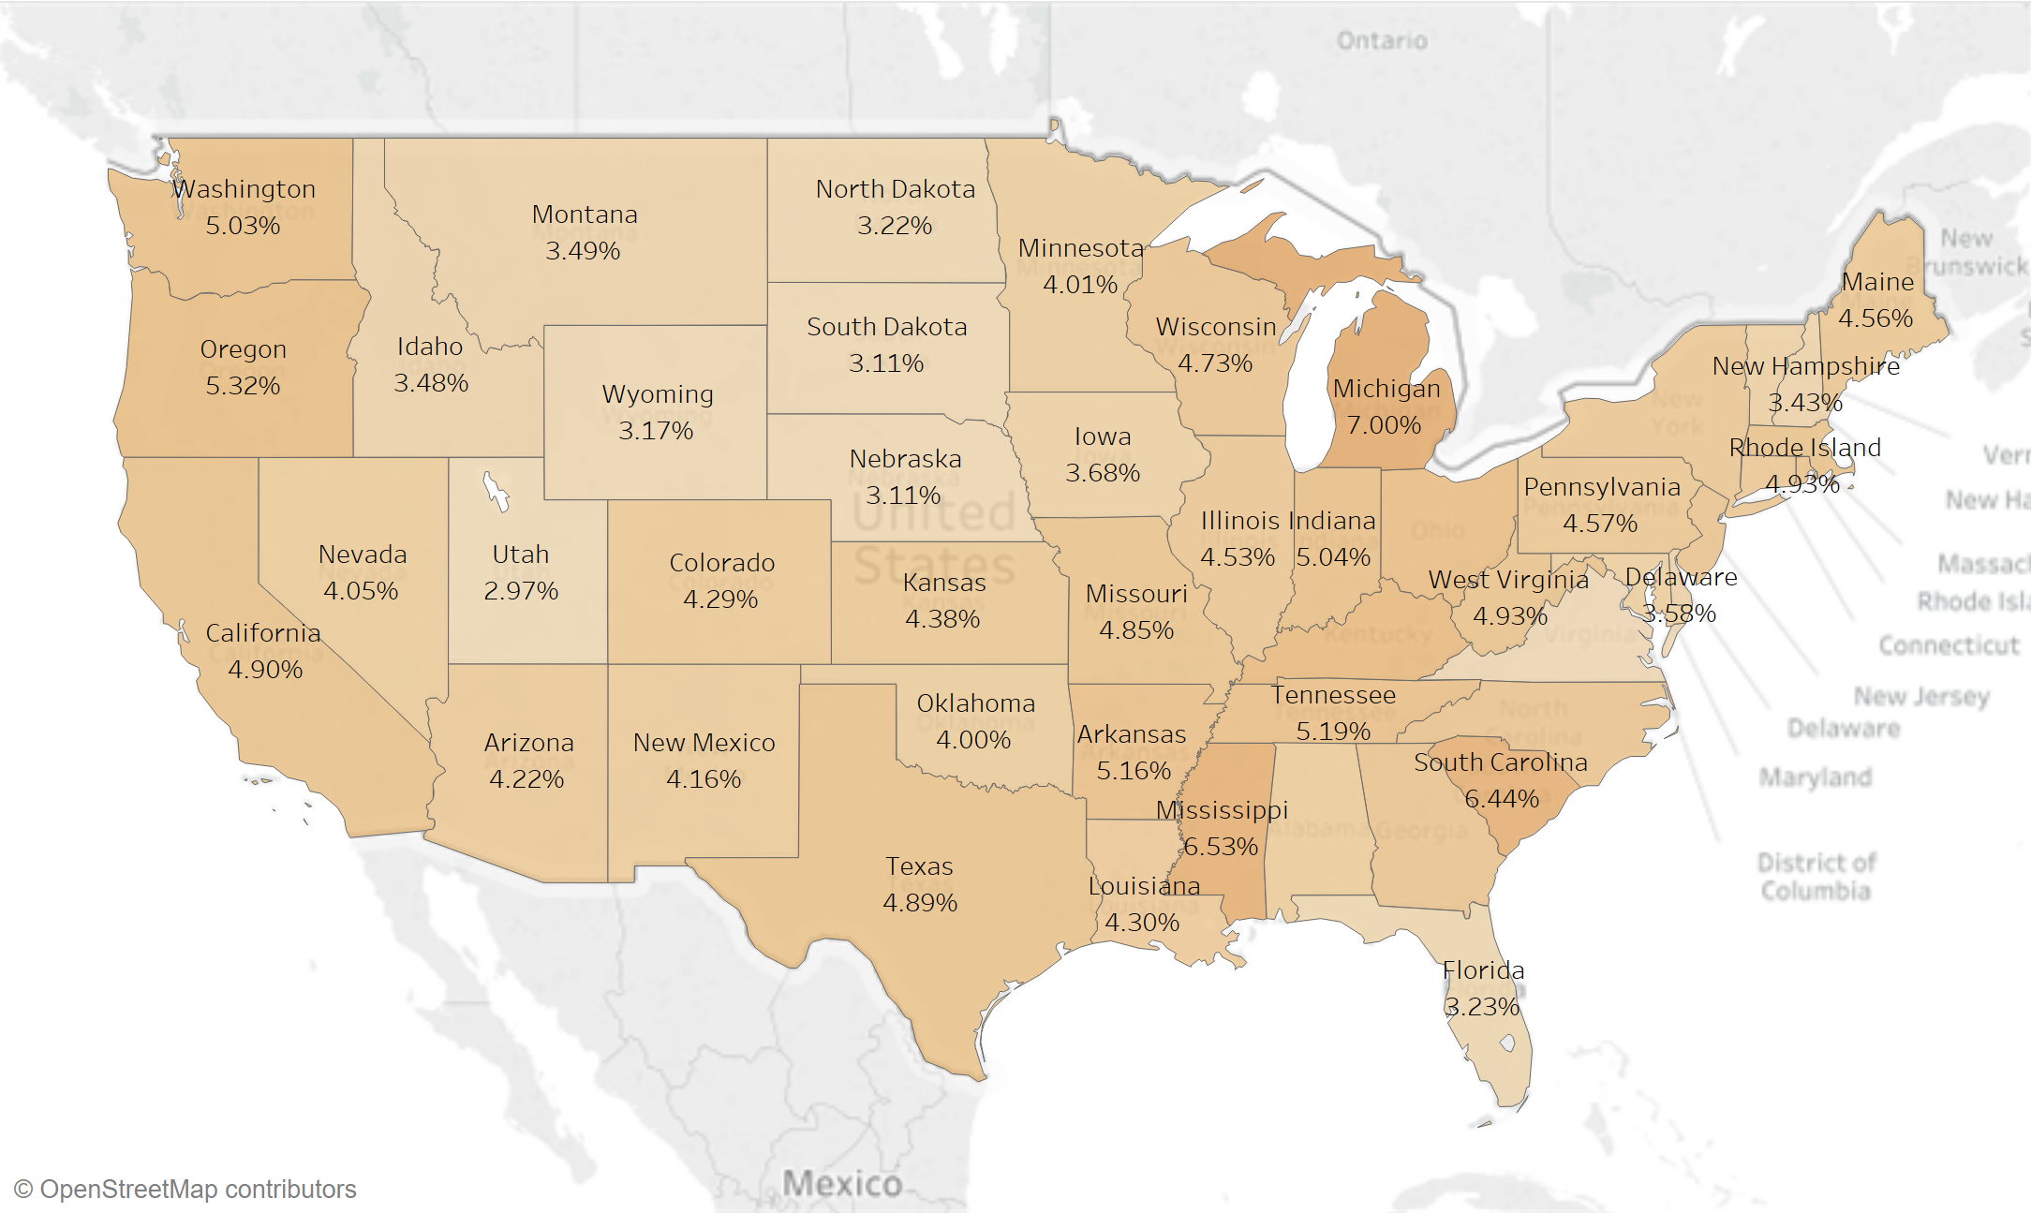
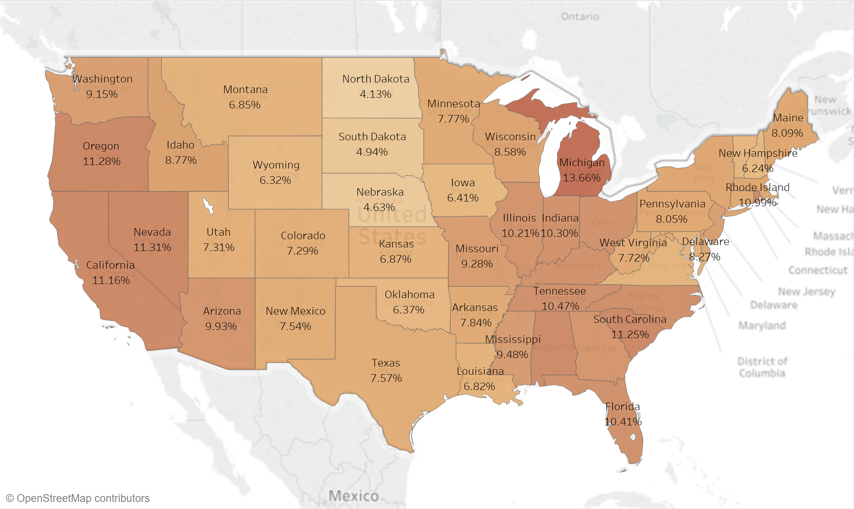
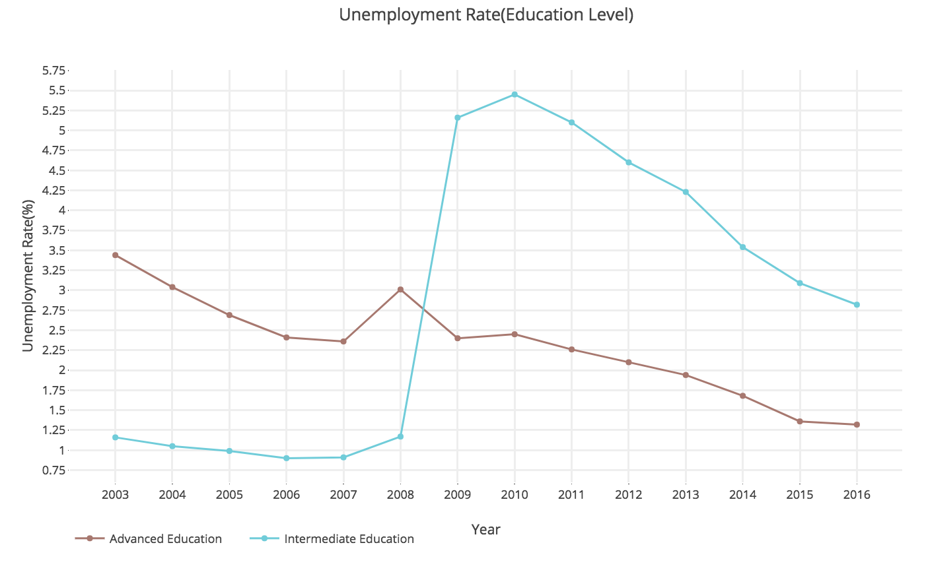
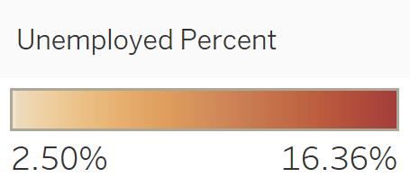
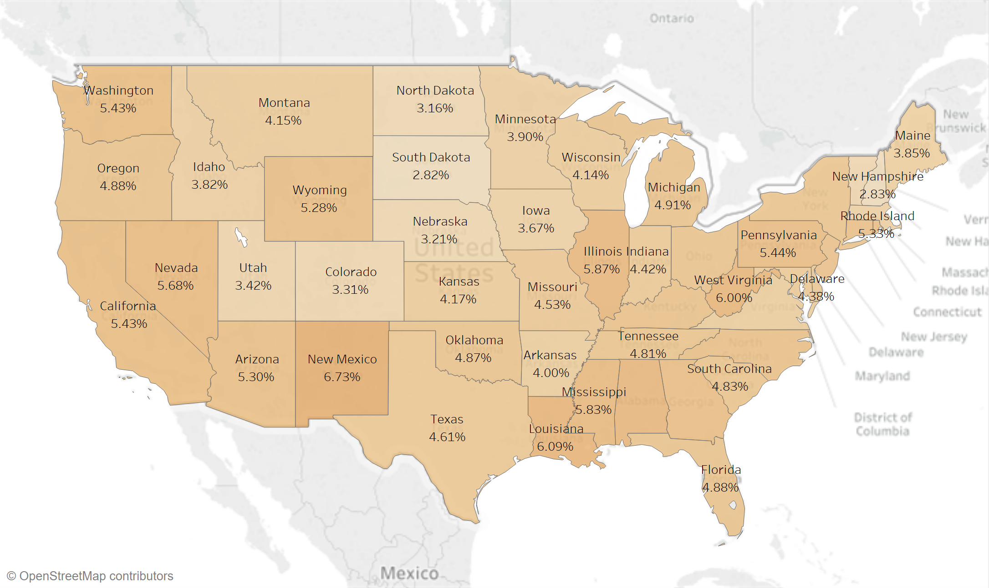
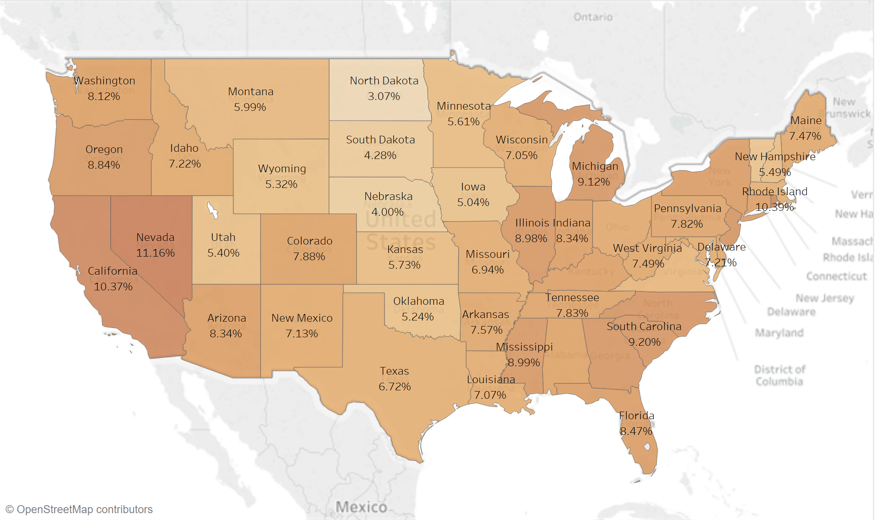
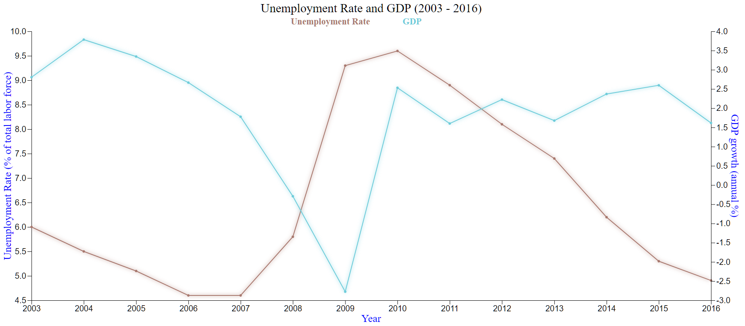
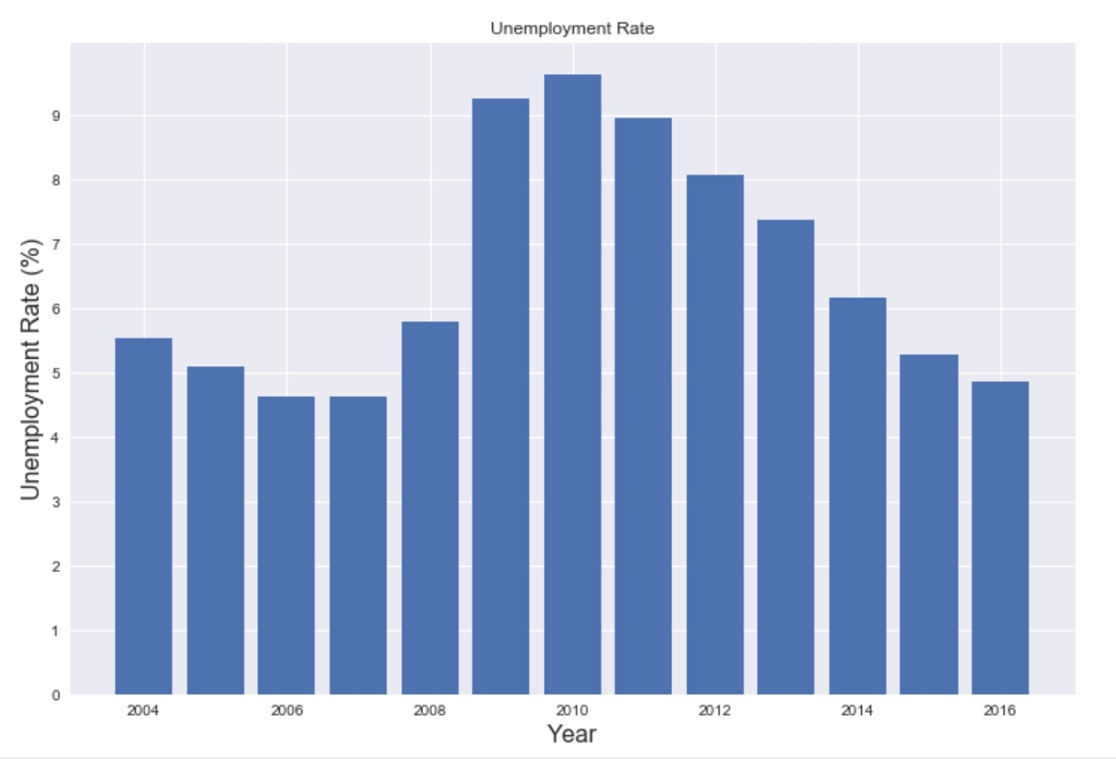
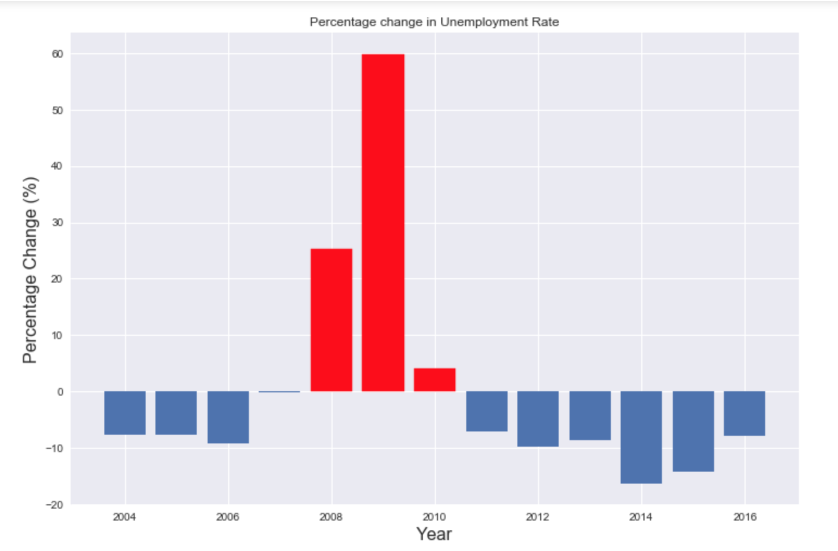
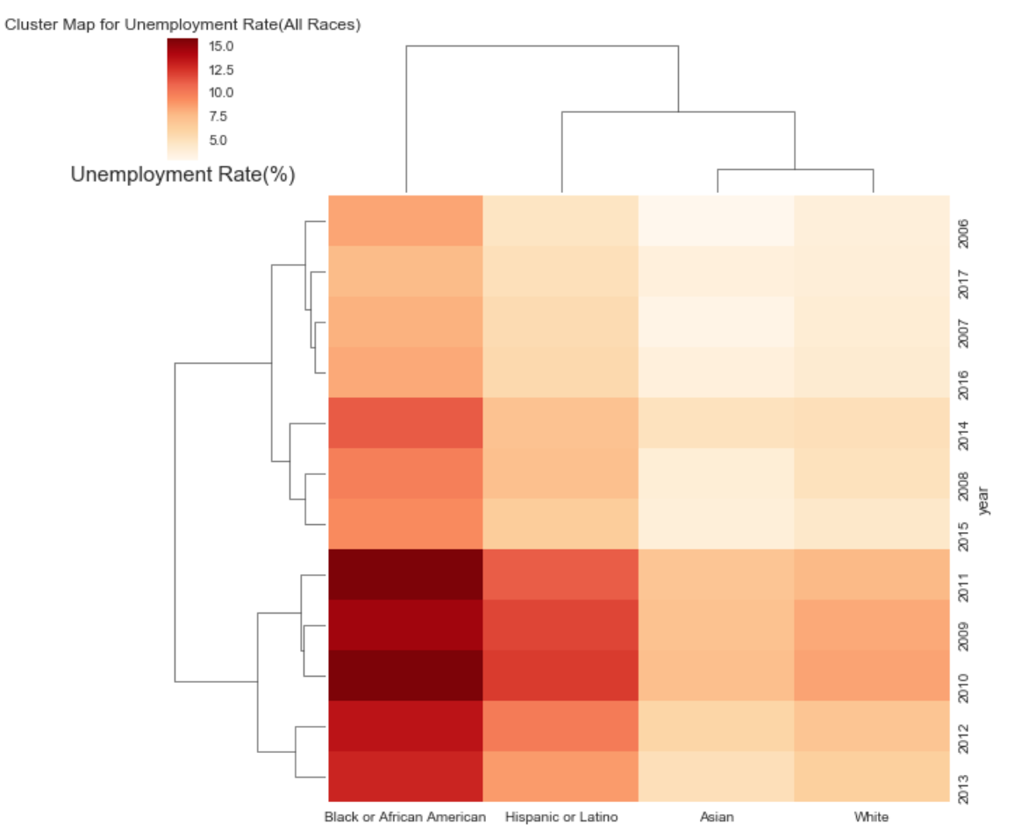
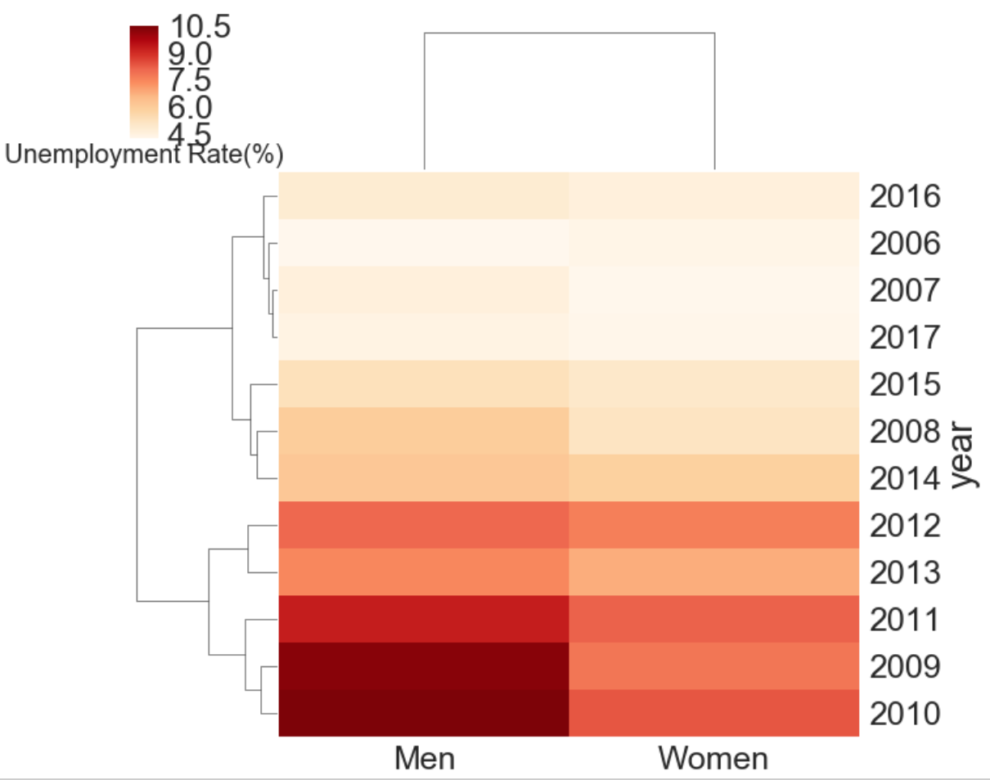
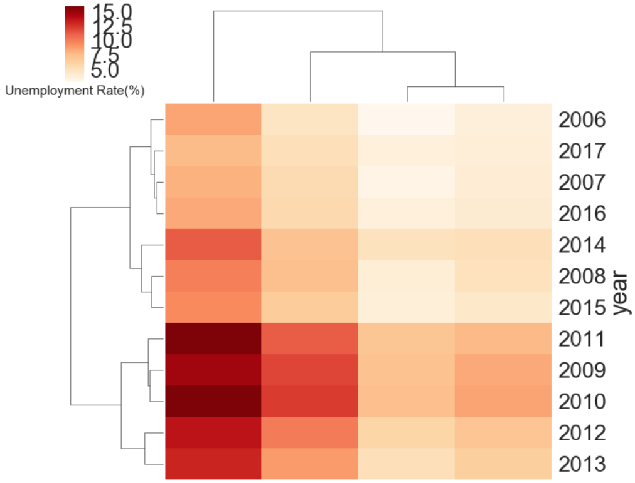
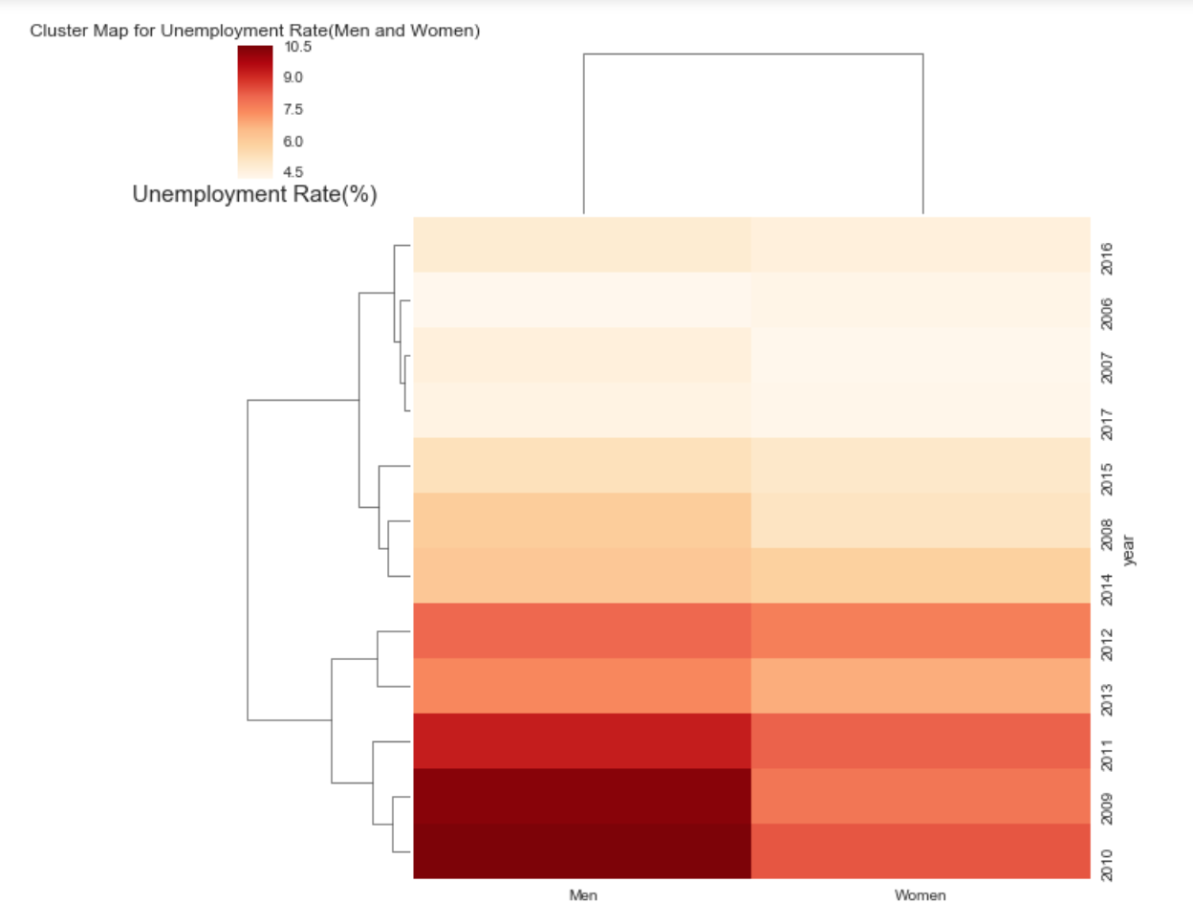
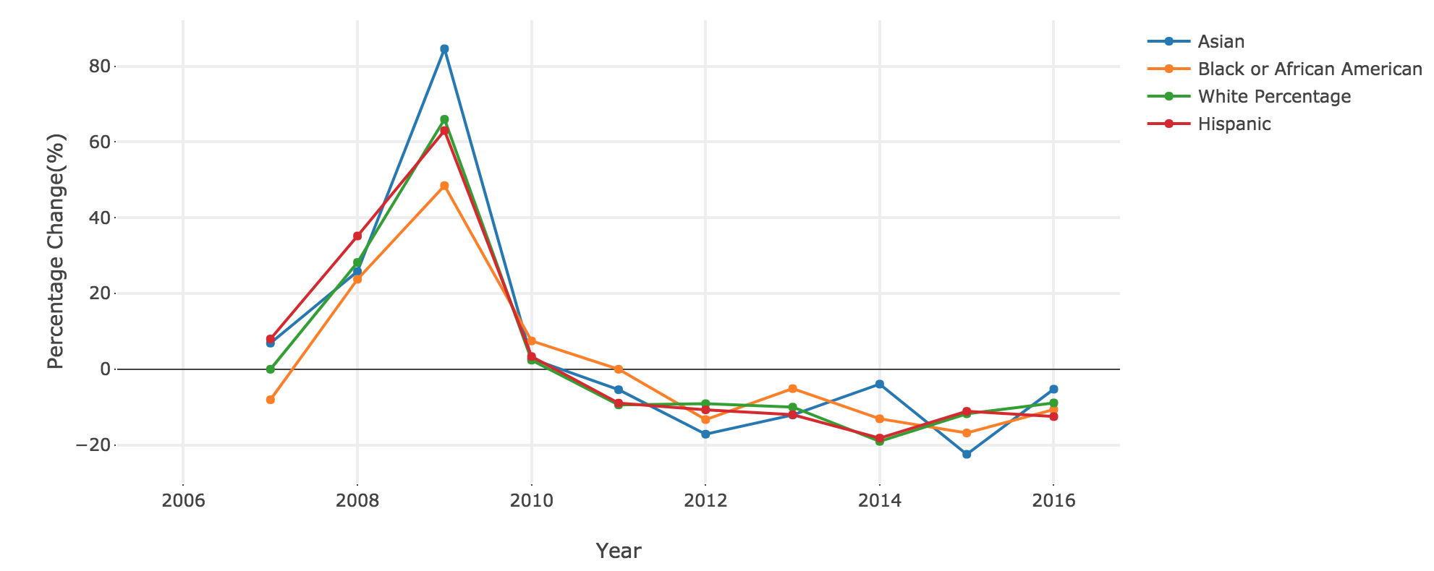
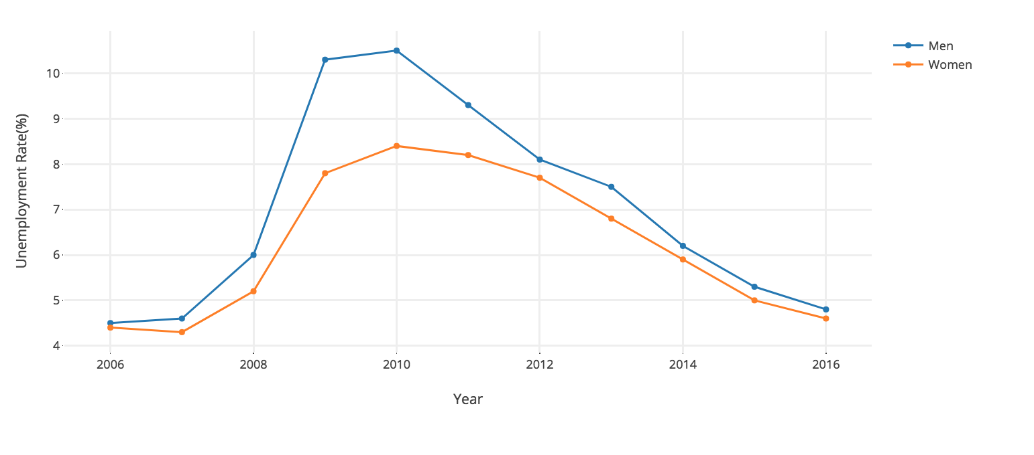
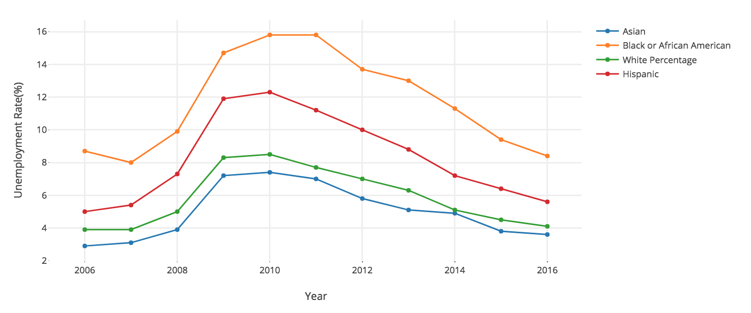
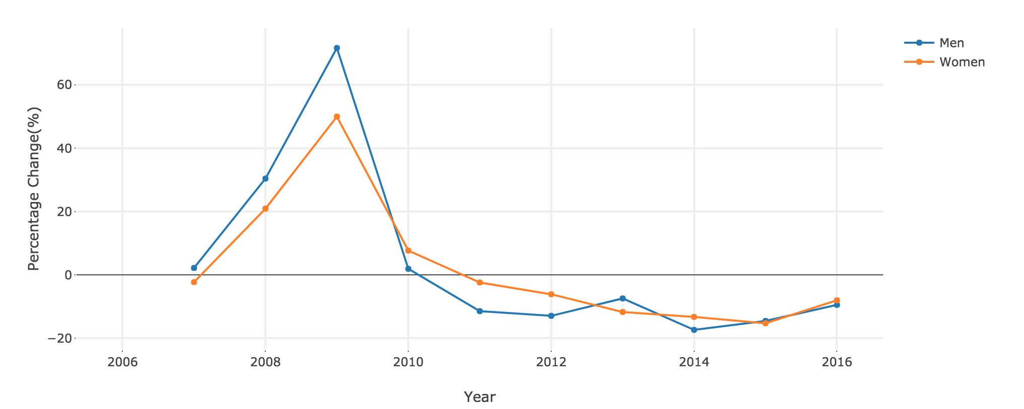
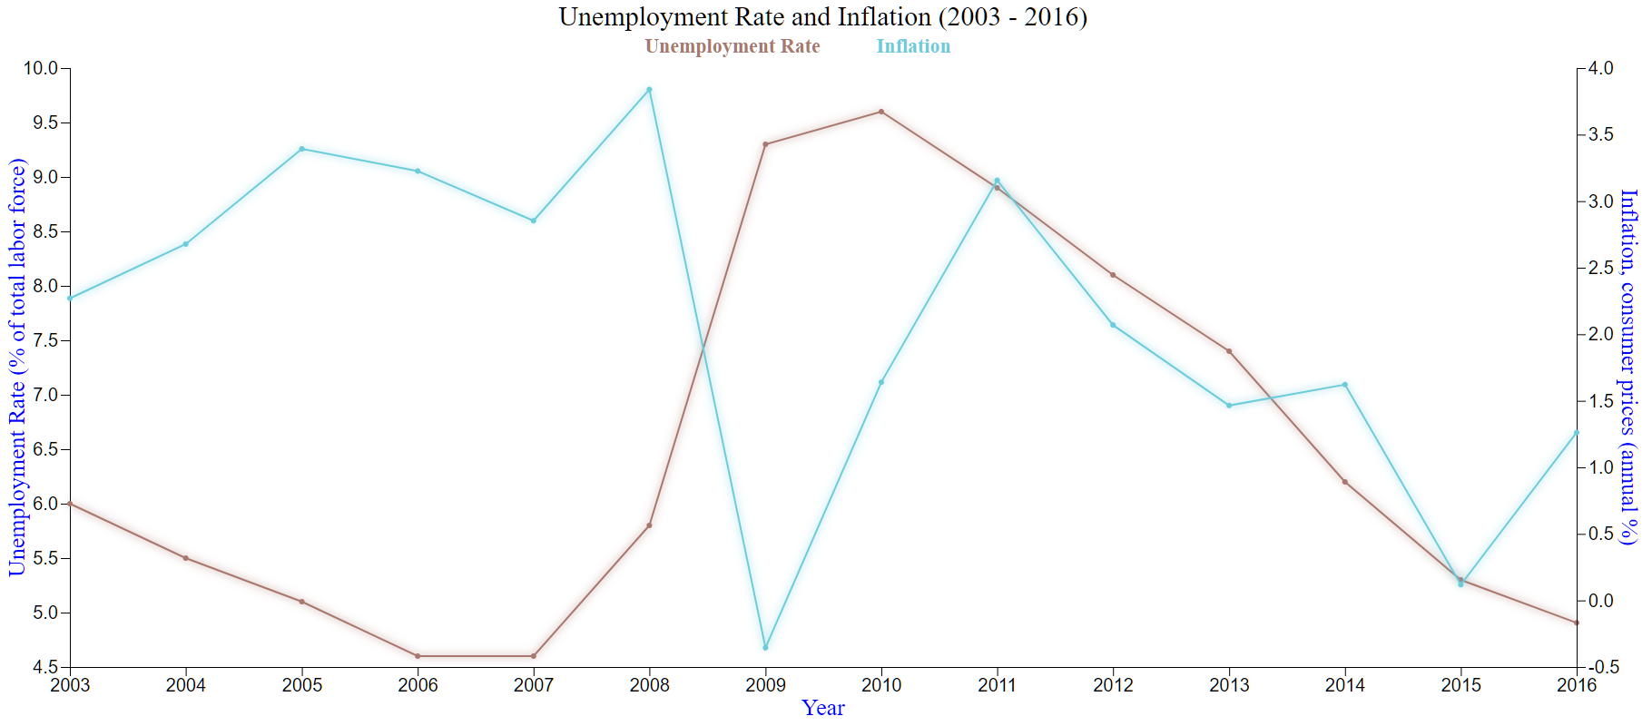
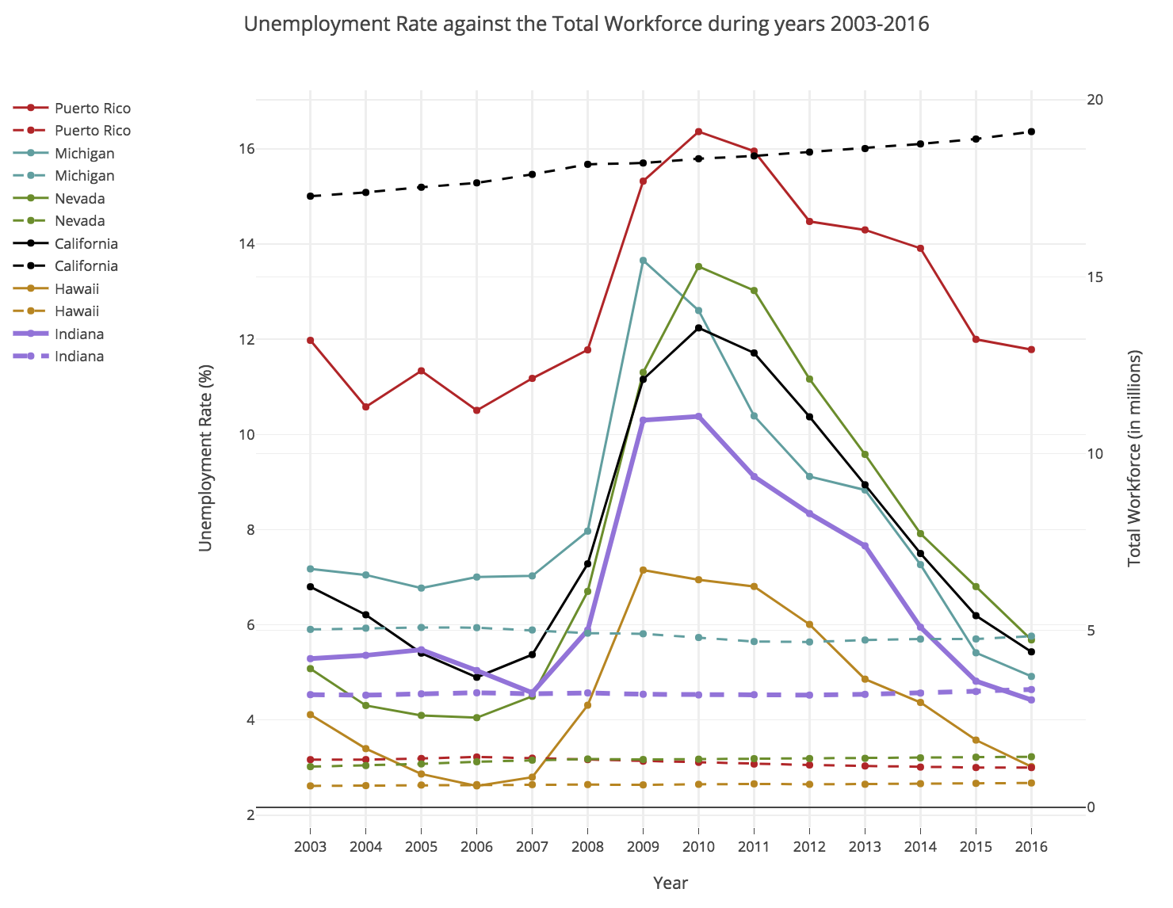
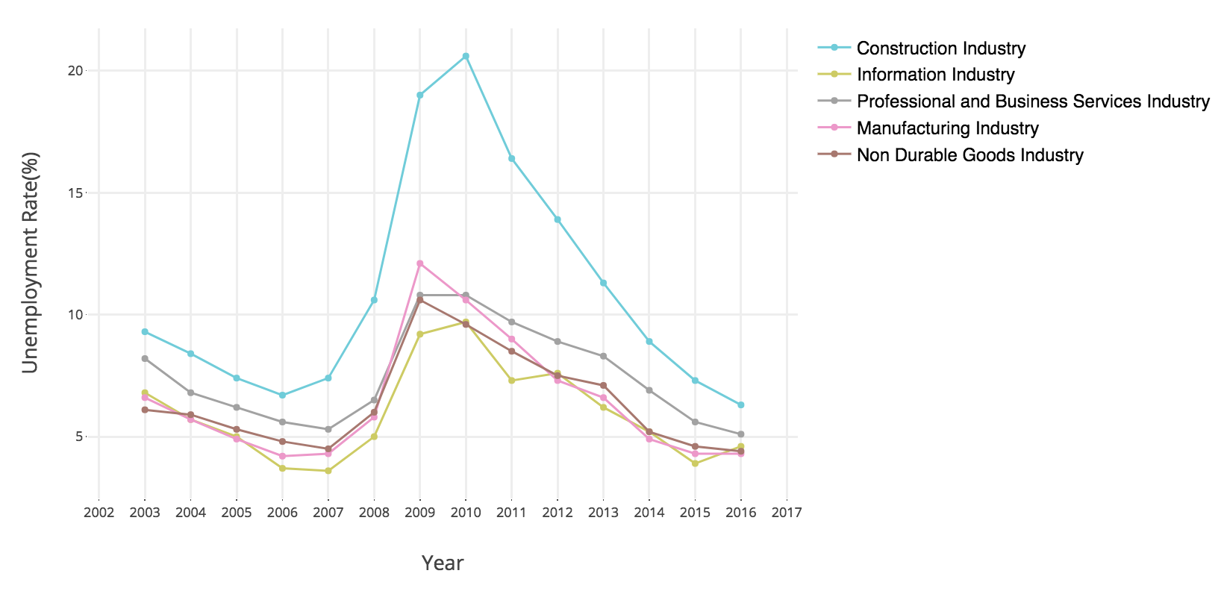
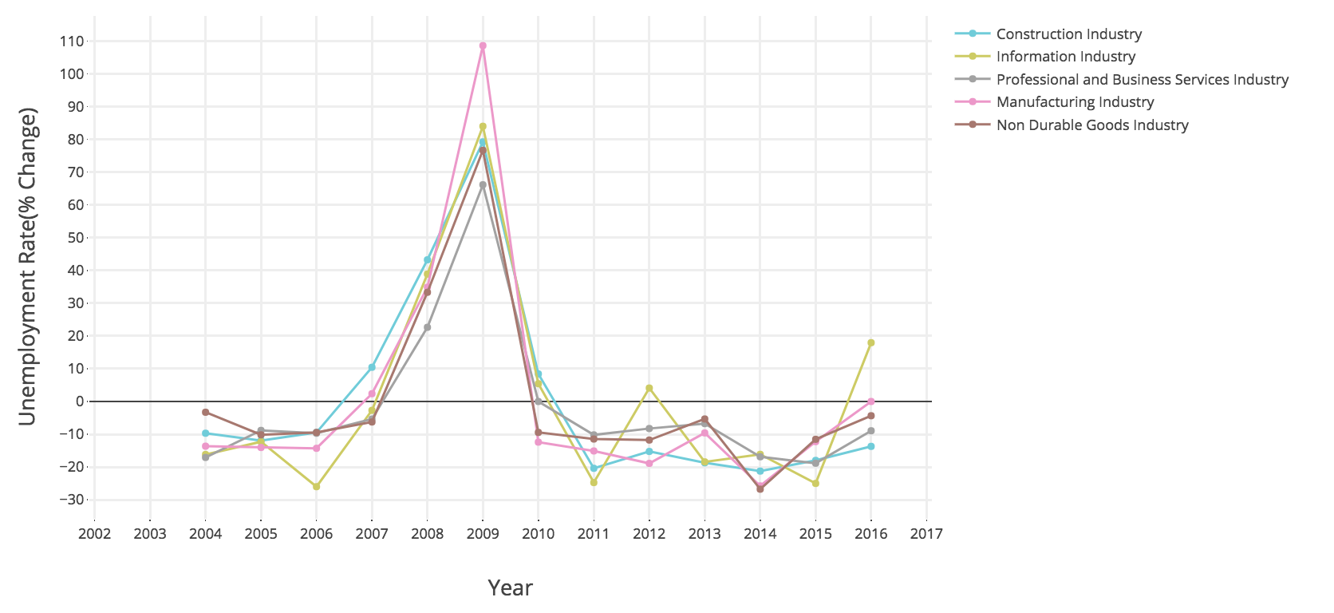




Causal effect of the Great Recession (2007-2009)
on Unemployment across the US
Karthik Anbazhagan, Shailendra Patil, Ankit Saxena [MS in Data Science]
ABSTRACT
State-wise Unemployment rates
Unemployment rates based on Educational Background
The general perception of the American population is that the US economy is yet to recover from the Great Recession of 2007-2009.
Our goal is to understand and reflect on some of the key factors affected by the Great Recession - pay, inflation, and unemployment rates across the US. Leveraging these statistics we hope to debunk the misconception that the US people have with respect to the economic recovery.
2006
2009
BACKGROUND
2016
2012
The U.S. economy faced one of its unrelenting economic difficulties in 2007, the Great Recession, which lasted until late 2009. This was the worst recession for the United States since the Great Depression of the 1930s . Americans suffered losses in wealth, especially in home investments, and annual unemployment rate hit an all time high of close to 9.5%
Fig: Change in unemployment rate years based on educational background.
People with intermediate educational background were affected massively by the Great Recession and are still yet to recover. People with advanced education have fared better during the decade.
Fig: Change in unemployment rate over the years across various states in the US.
We observe a very similar unemployment rate in 2016 (post-recession) as compared to 2006 (pre-recession)
GDP vs Unemployment Rates
Gender-wise Unemployment rates
Race-wise Unemployment rates
MYTH AND BELIEF
Fig: GDP growth rate vs Unemployment rate change.
GDP growth percentage started to declined in 2004 but 2007-2009 saw the greatest decline, starting the Great Recession. Since then, the US has greatly recovered compared to other countries around the world.
“A decade after Great Recession, one in three Americans still feel as they haven’t recovered from the recession” – CNBC
“53 percent of Republicans think the unemployment rate has risen under Obama” – The Washington post
“In 2015, six years from the end of the recession, total U.S. employment was 148 million compared to a pre-recession peak of 146 million. Meanwhile the population of working age people rose by 17.5 million, more than the 1.7 million employment gain” – Forbes
Blacks / Hispanic Asian White
African American
Fig: The cluster map forms a cluster (of years) based on similar unemployment rates.
The bottom two highlighted clusters indicates a higher unemployment rate (around the time of recession). Likewise, the upper two highlighted clusters indicate a lower unemployment rate (pre/post stability).
Inflation vs Unemployment Rates
OBJECTIVE
Understanding the correlation of various entities affected by the Great Recession:
Unemployment rates across various states
Unemployment rates across various demographics, job types, and education background
GDP vs inflation vs unemployment rates
Mapping the recovery of the US since recession
Fig: Trend of unemployment rates across gender and race.
Fig: Inflation (consumer prices) with changes in unemployment rates.
During the year 2008, US saw the maximum inflation which lead to a decline in GDP growth percentage starting the Great Recession. Since then, the inflation has fluctuated and caused instability in the US markets.
OBSERVATIONS
CONCLUSION
Workforce vs Unemployment rates
Fig: YoY percentage change in unemployment rates across gender and race.
Men we affected more than women during the Great Recession.
Asians and Whites were affected more compared to the other races but they have recovered quicker than the rest.
Leveraging the detailed analysis and the statistics that we have plotted, we are able to conclude that the Great Recession is no longer in effect or has a very diminished effect on the overall unemployment.
Demographic statistics highlights majority of states to perform better than the pre-recession period. Even with the surge in workforce, strong decline in the unemployment rates indicates that more jobs are generated and the economy is having a stable growth.
We hope that this project is able to debunk the misconception that the people of US have about how the economy is yet to recover from the great recession.
Unemployment rates across major Industries
Fig: The dotted lines represent labor force and the solid lines represent the unemployment percent between 2003 and 2016.
Even with an increase in workforce, we see a decline in unemployment rate indicating a positive growth in the job market
Fig: Unemployment rates across the five most affected industries in the US.
Acknowledgment
We would like to thank our professor Yong-Yeol Ahn and the associate instructors for their valuable guidance through every phase of this project.
Done as a part of INFO I590 Data Visualization course at Indiana University, Bloomington.

